Slide 1
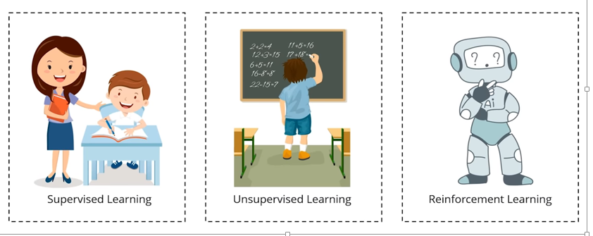
Types of Machine Learning

Slide 2
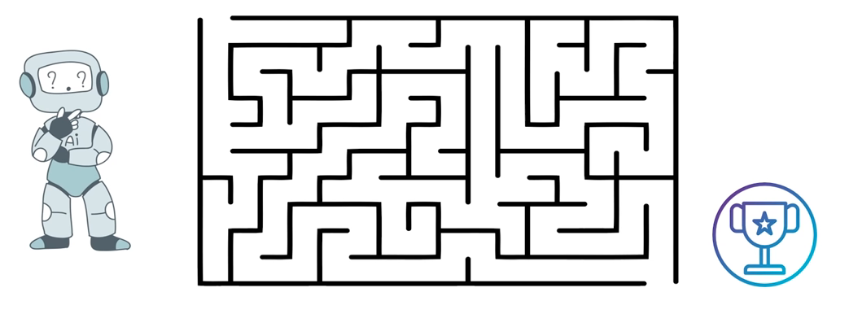
Reinforcement Learning

Slide 3
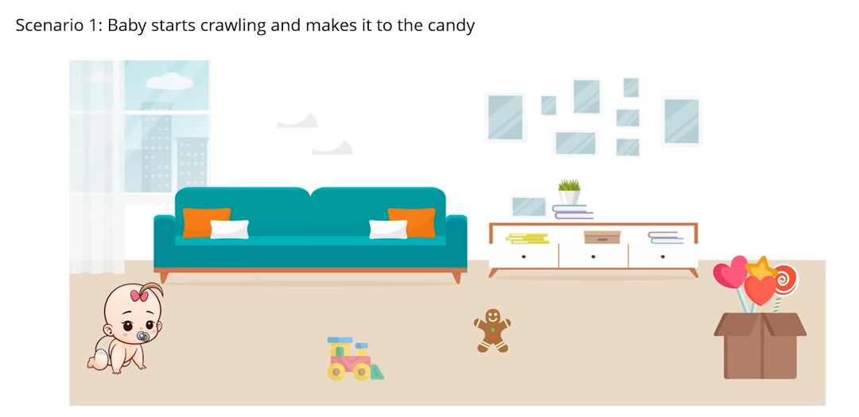
Reinforcement Learning with An Analogy

Slide 4
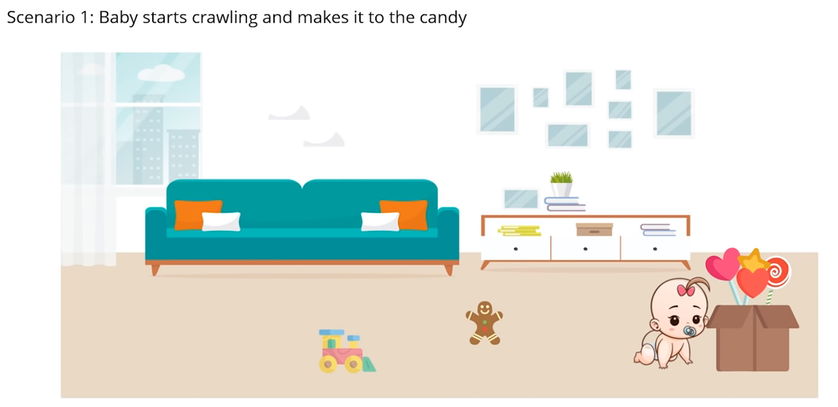
Reinforcement Learning with An Analogy

Slide 5
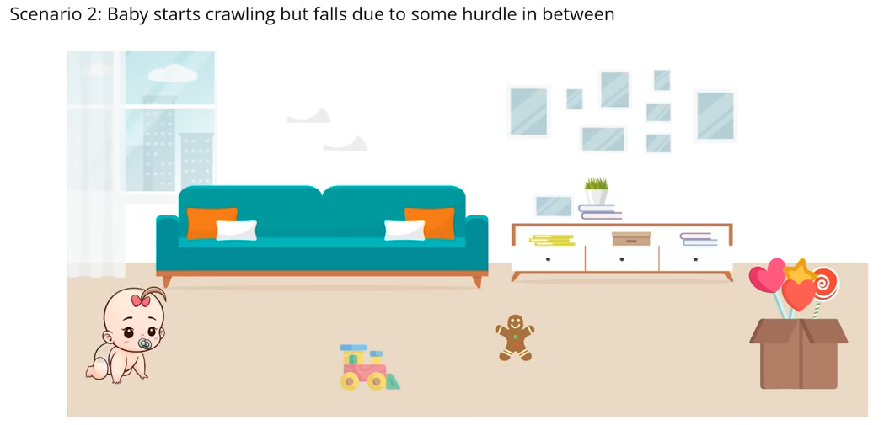
Reinforcement Learning with An Analogy

Slide 6
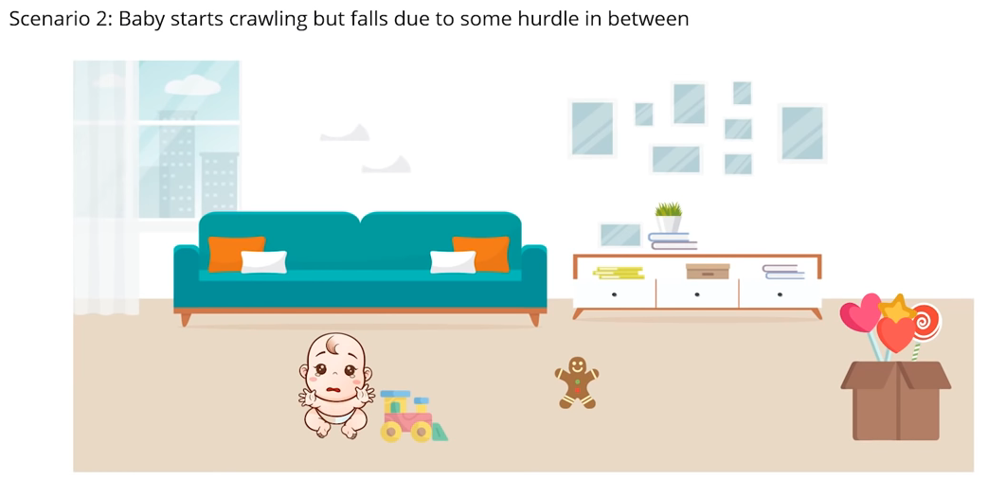
Reinforcement Learning with An Analogy

Slide 7
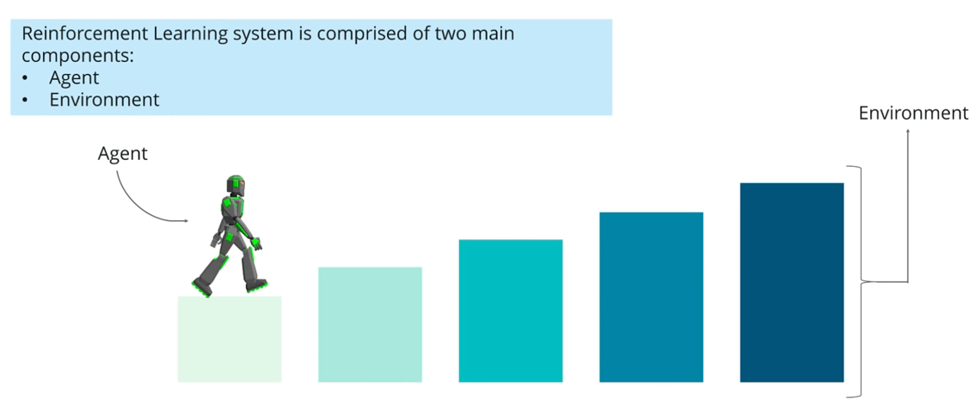
Reinforcement Learning Process

Slide 8

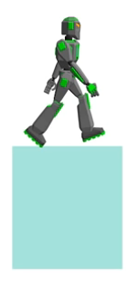
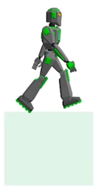
Reinforcement Learning Process

Slide 9
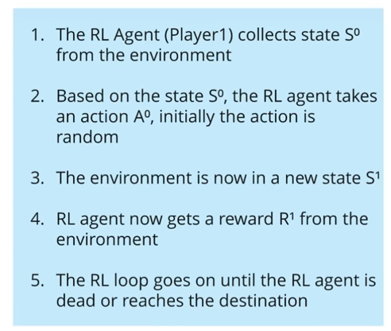
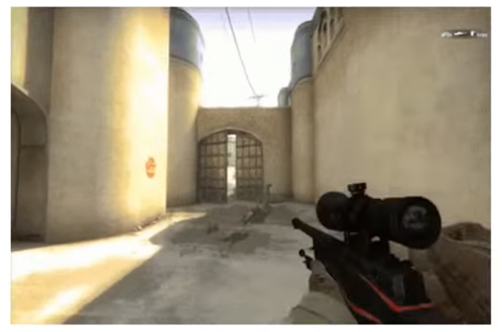
Reinforcement Learning Process : Counter Strike

Slide 10
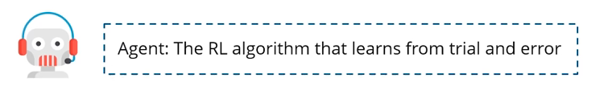



Reinforcement Learning Definitions

Slide 11

Reinforcement Learning Definitions

Slide 12
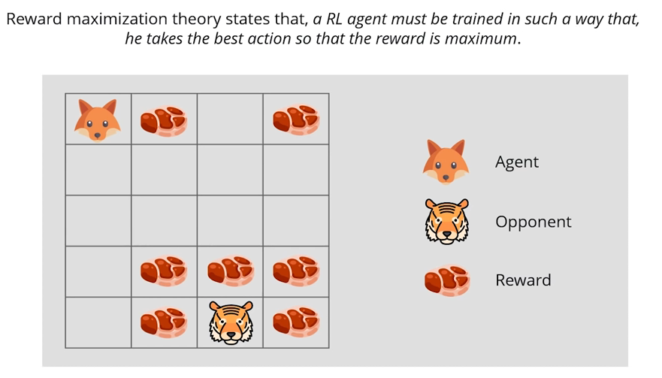
Reward Maximization

Slide 13

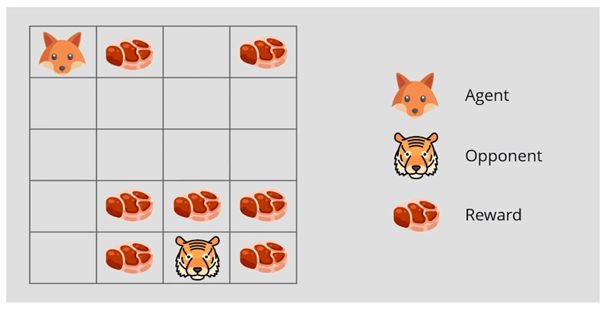
Exploitation & Exploration

Slide 14
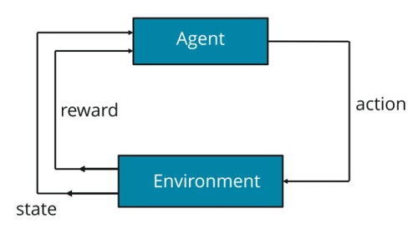
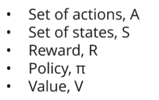
Markov Decision Process (MDP)

Slide 15
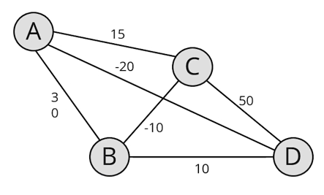
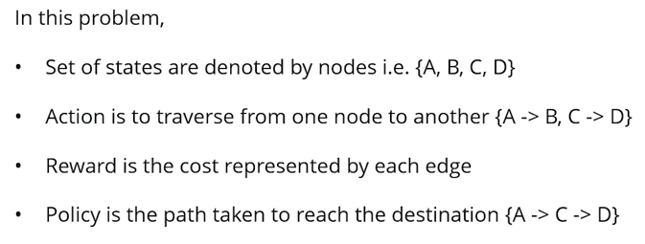
Markov Decision Process : Shortest Path Problem

Slide 16
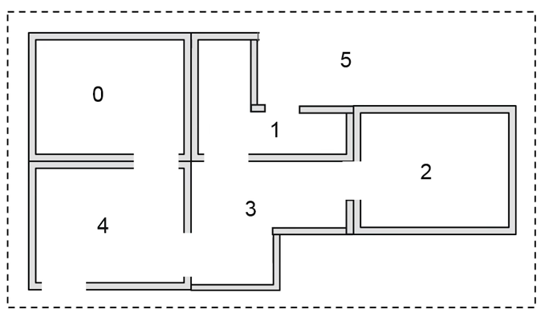
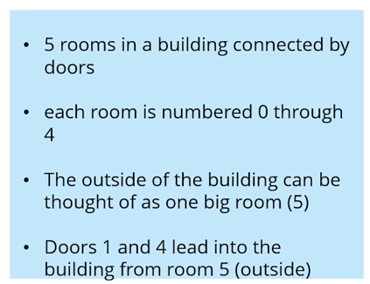
Q Learning Algorithm

Slide 17
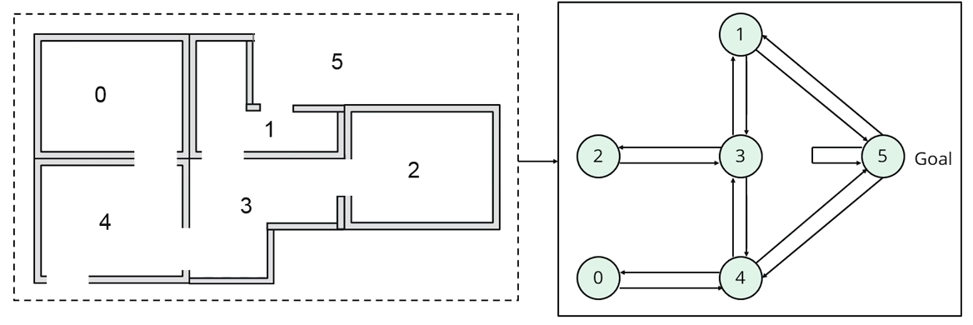
Q Learning Algorithm

Slide 18

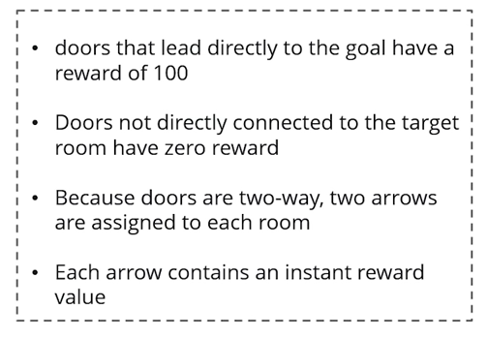
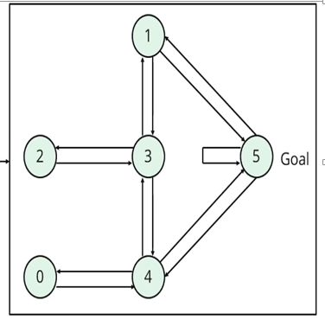
Q Learning Algorithm

Slide 19
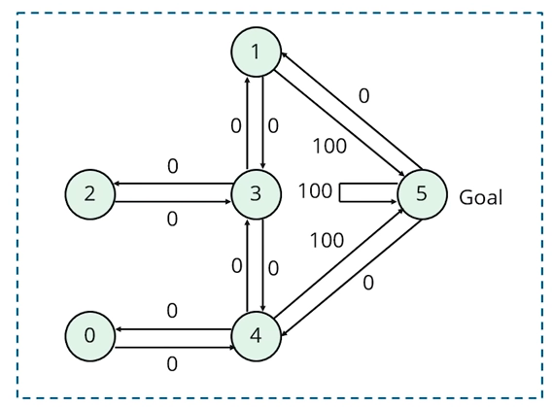
Q Learning Algorithm

Slide 20
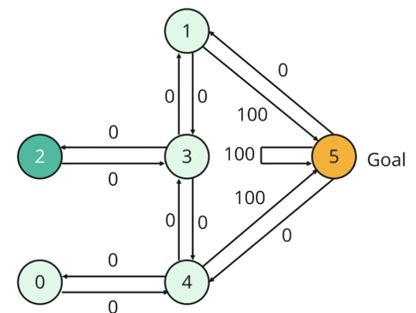
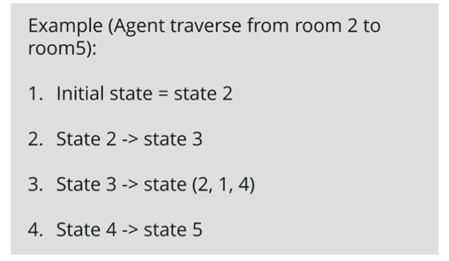
Q Learning Algorithm

Slide 21
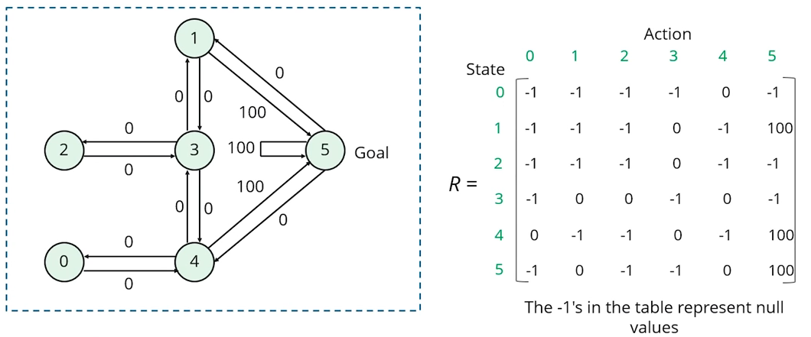
Q Learning Algorithm

Slide 22
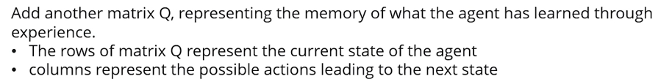
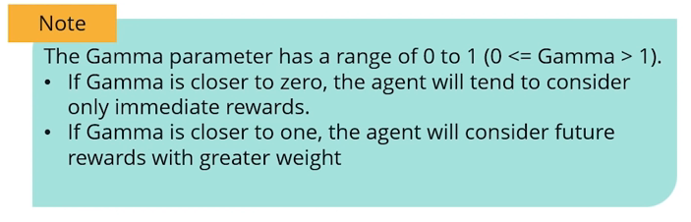
Q Learning Algorithm

Slide 23
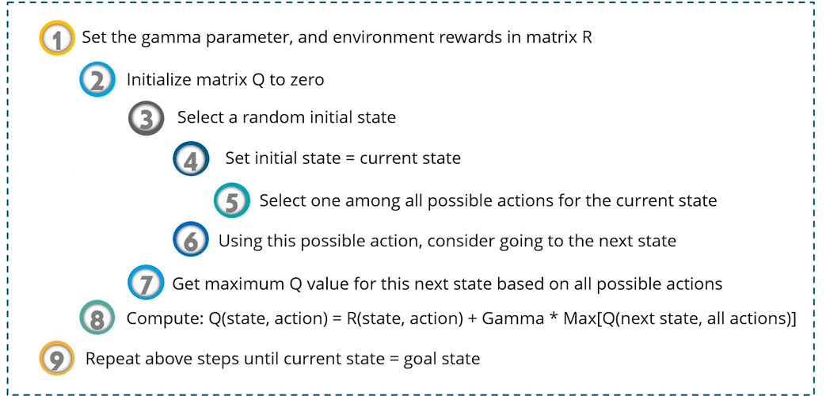
Q Learning Algorithm

Slide 24
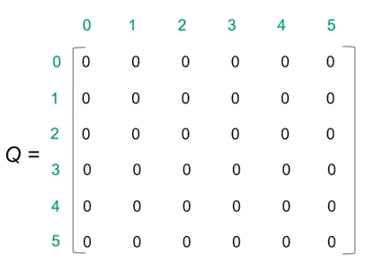
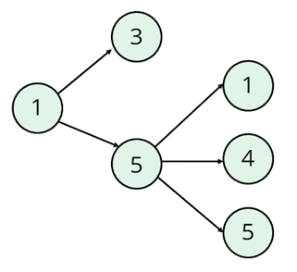
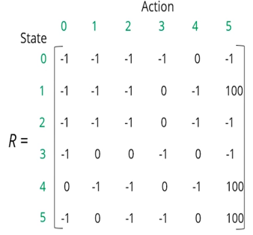
Q Learning Algorithm

Slide 25
Q Learning Algorithm

Slide 26
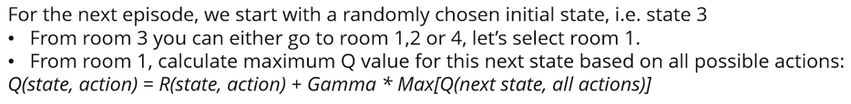
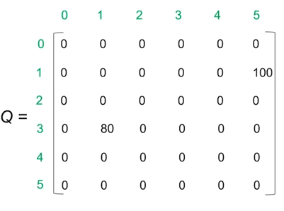
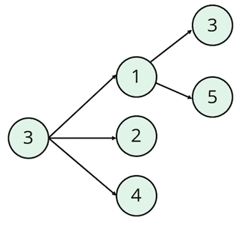
Q Learning Algorithm

Slide 27
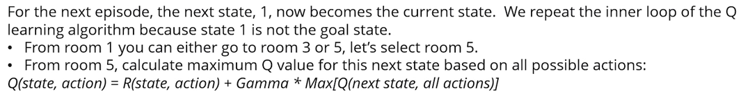
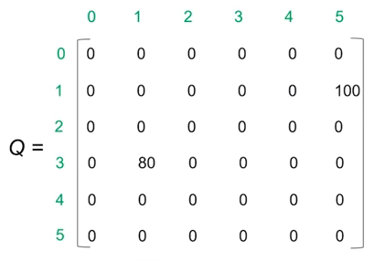
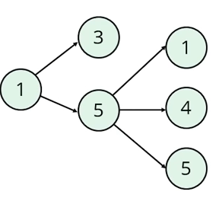
Q Learning Algorithm

Slide 28
Robot in a room
 |  |  | +1
 |  |  | -1
START
actions: UP, DOWN, LEFT, RIGHT
UP
80% move UP
10% move LEFT
10% move RIGHT
reward +1 at [4,3], -1 at [4,2]
reward -0.04 for each step
what’s the strategy to achieve max reward?
Notes:
want to learn a policy (what’s the solution?)
can we learn it using (un)supervised learning? why not?
so how do we learn it? any ideas?
let the robot explore the environment

Slide 29
Resource allocation in datacenters
A Hybrid Reinforcement Learning Approach to Autonomic Resource Allocation
loadbalancer
application A
application B
application C

Slide 30
Thank You

